Slide 1
Medical Equipment and Pharma Sales Dashboard
Ankita Nademwar
Analyst Intern
Project Duration: 15 Oct 2025 – 31 Oct 2025
Tool: Microsoft Power BI
Organization: Zaalima Development pvt. Ltd.

Slide 2
Problem Statement & Objectives
The sales team faced difficulty tracking performance across medical and pharma divisions.
Manual reporting caused delays in decision-making.
Objectives:
• Combine medical equipment and pharma sales data.
• Track Total Sales, Units, and Margin.
• Identify top-performing products, hospitals, and regions.
• Provide an interactive dashboard for insights.

Slide 3
Data Overview
Source: Internal medical and pharma sales dataset (CSV).
Duration: 2024 – 2025 | Records: 10,000+
Key Fields: Date, Region, Hospital, Product, Manufacturer, Sales, Units, Margin.
Purpose: To analyze performance and identify sales trends.

Slide 4
Data Preparation
• Cleaned nulls, duplicates, and standardized formats.
• Removed redundant Month/Year columns.
• Added calculated measures: Total Sales, Total Units, Gross Margin %.
• Modeled relationships and built time hierarchy in Power BI.

Slide 5
Dashboard Design Approach
• Used a Green theme to represent healthcare and trust.
• Divided dashboard into three main pages: Overview, Product Deep Dive, Region Insights.
• Added slicers, drill-through, and map visuals for interactivity.

Slide 6
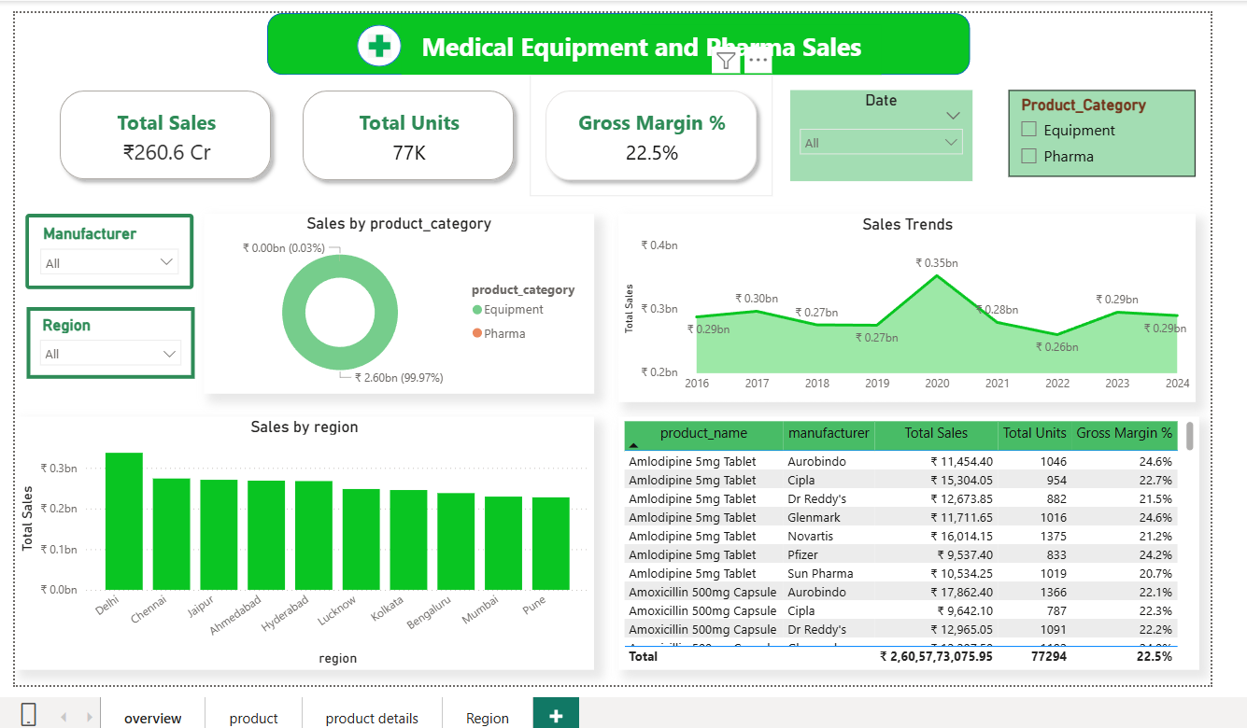
1-Overview page

Slide 7
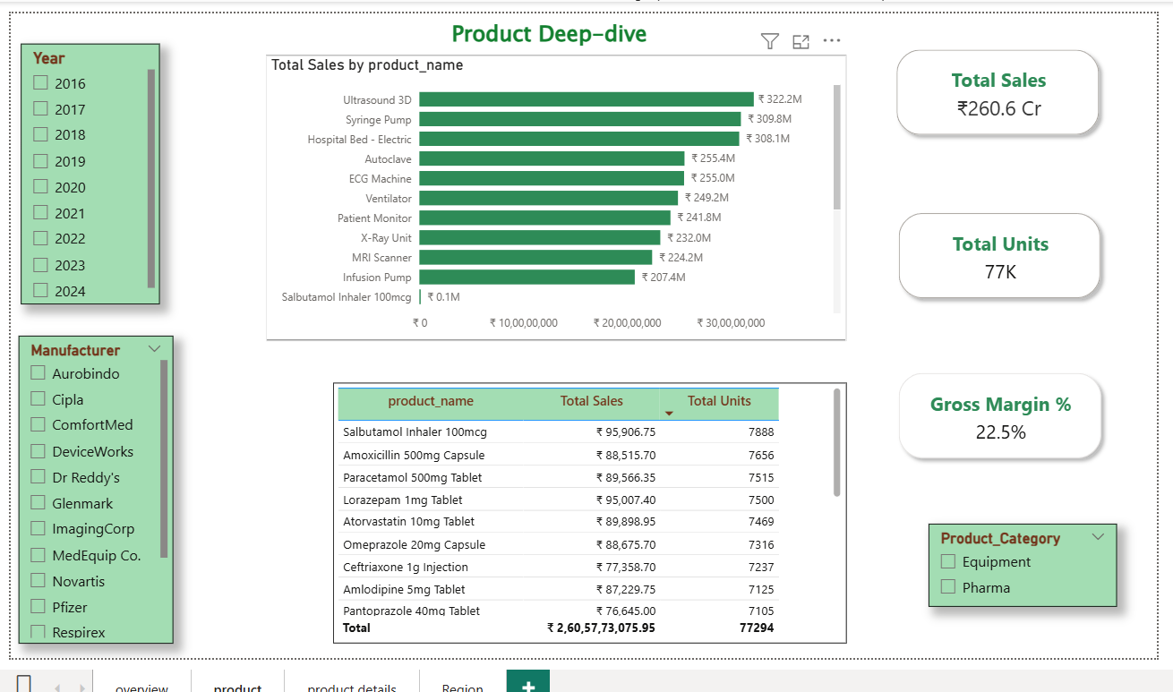
2-Product Deep-dive page

Slide 8
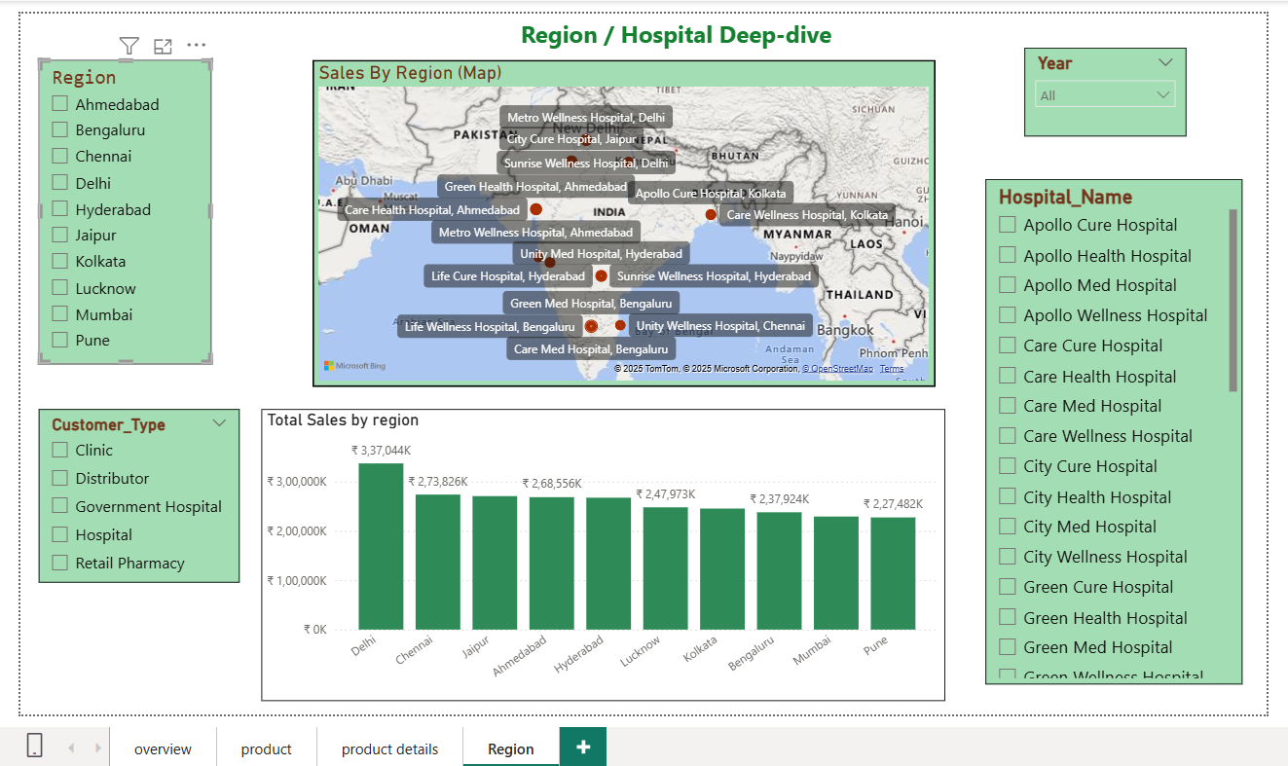
3-Region Deep-dive Page

Slide 9
Key Findings
Total Sales across all regions amounted to ₹260.6 Cr with 77K total units sold and an average Gross Margin of 22.5%.
• Delhi, Chennai, and Jaipur emerged as the top-performing regions in terms of total revenue.
• Equipment category contributed to nearly all the total sales, indicating a dominant product line compared to Pharma.
• Top-selling products include Ultrasound 3D, Syringe Pump, and Hospital Bed - Electric, showing strong demand in diagnostic and patient care equipment.
• Aurobindo, Cipla, and Dr. Reddy’s were among the leading manufacturers contributing to total sales.

Slide 10
Recommendations
• Focus sales efforts on high-performing regions such as Delhi and Chennai.
• Increase marketing and distributor support in lower-performing cities.
• Expand partnerships with large hospital networks to increase recurring sales.
• Implement predictive modeling in Power BI for future sales forecasting.
• Continue integrating new data for continuous performance monitoring.

Slide 11
Tools & Tech Stack
• Tools: Power BI, Excel, GitHub.
• Version Control: Git commits were regularly updated to track project evolution.
• Challenges: Handling data joins, ensuring proper relationships, and managing DAX performance optimization.

Slide 12
Conclusion
This dashboard successfully delivers actionable insights into the sales performance of the Medical Equipment and Pharma sectors. By leveraging Power BI’s interactive features, it enhances visibility across business dimensions and supports data-driven decision-making.

Slide 13
Thank you !!
-Ankita Nademwar, Data Analyst Intern

